Slide 1
CAPER Meeting Research Project
By: Morey Agnew

Slide 2
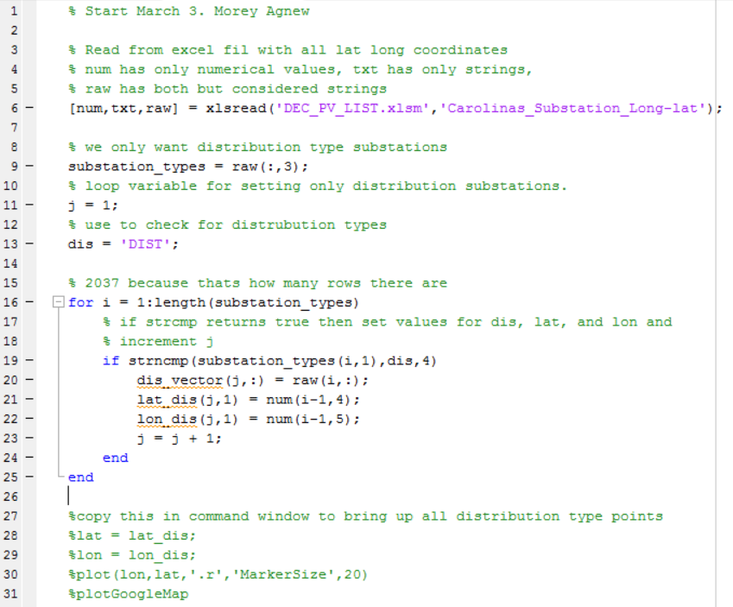
Matlab Code
We use this code with the plotGoogleMap.m.
First run this code to get all distribution type substations sorted and then run the plotGoogleMap.m program with the bottom four lines to get all 749 distribution type substations.

Slide 3
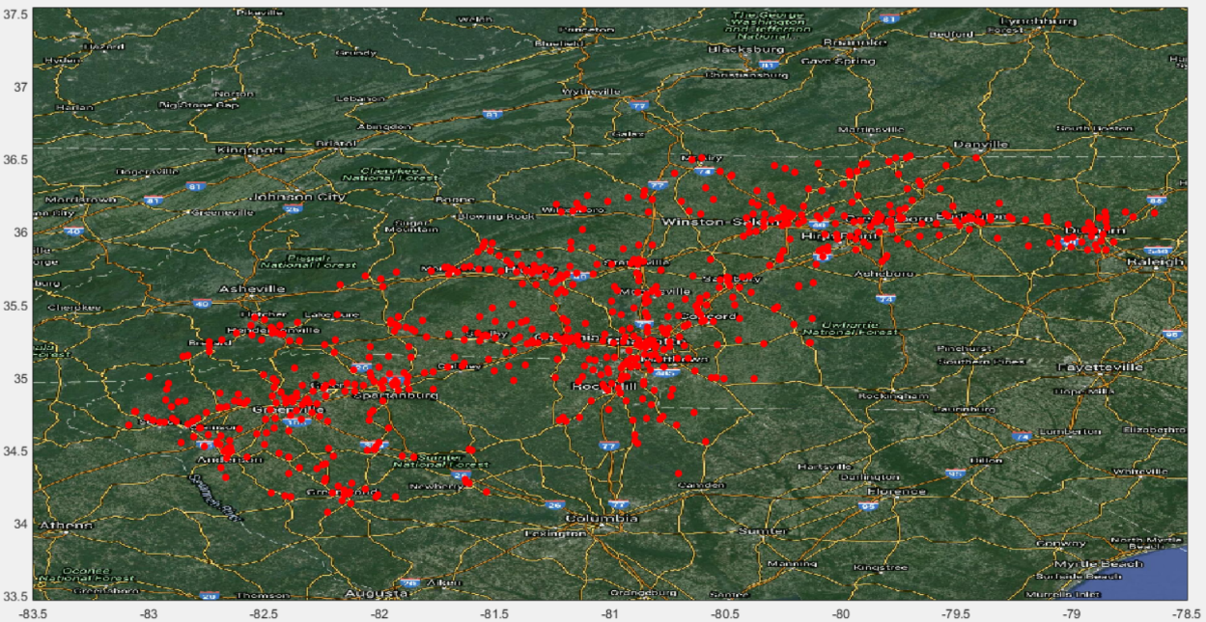
Picture of Map
This map is made from plotGoogleMap.m using the latitudes and longitudes of each distribution type substation. Now we will zoom in on national forest.

Slide 4
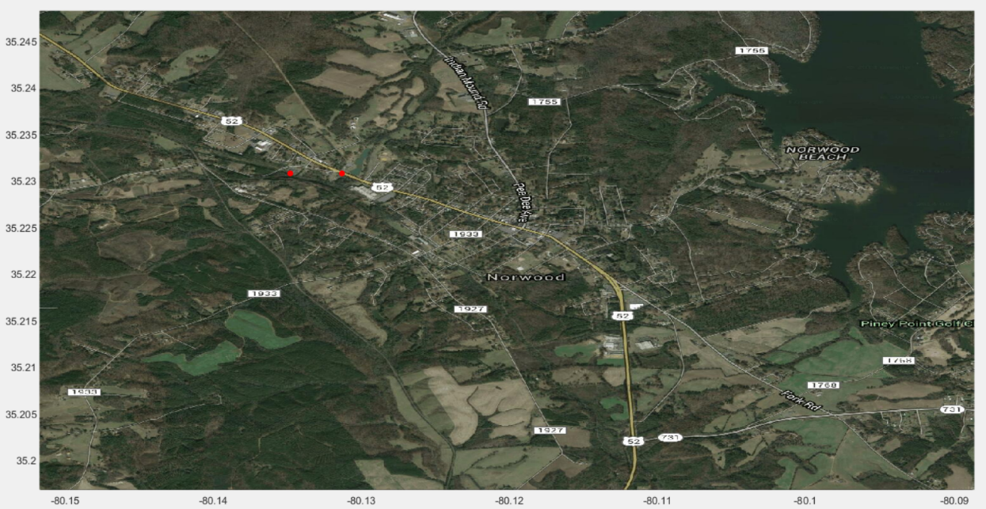
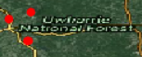
Zoomed in pictures of map

Slide 5
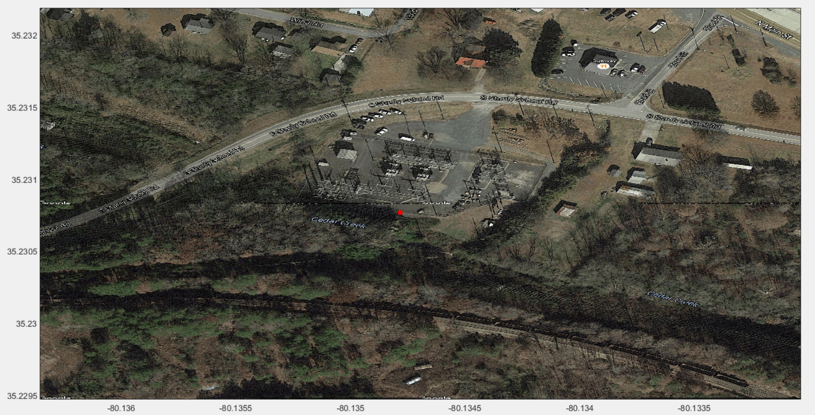
Picture of the substation

